Slide 1
Progress Report
1/31/2025
Milton Tinoco

Slide 2
Microcontroller Reading EMGs signals
The microcontroller was configured to read ADC values at a rate of 1000 Hz and then transfer them to a Python script for saving to a file.
The following slides explain the configuration and tests conducted to verify system performance.

Slide 3
ADC Configuration
The ADC was configured to use 3 channels to accommodate the three surface electrodes used in the project.
ADC DMA was enabled to allow non-blocking data transfers.
Scan mode was enabled to support multiple channels.
DMA requests were enabled so that data is transferred after each channel's ADC conversion is finished.
The ADC trigger was set to TIMER 3.
ADC DMA was set to circular mode to continuously update the buffer.

Slide 4
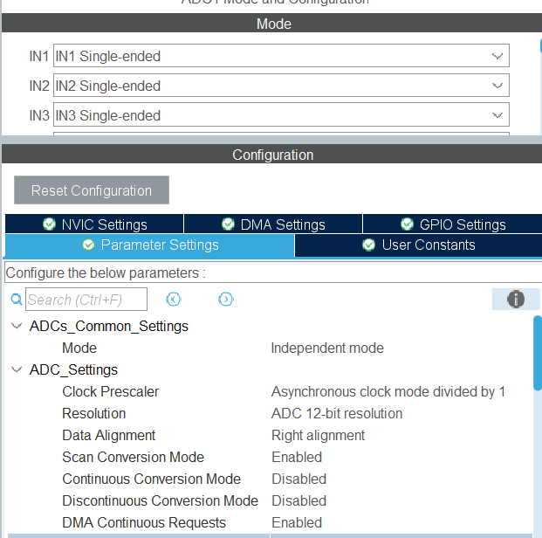
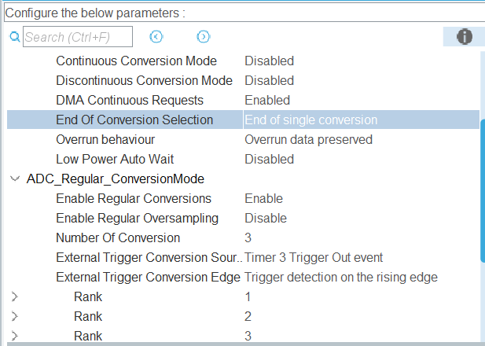
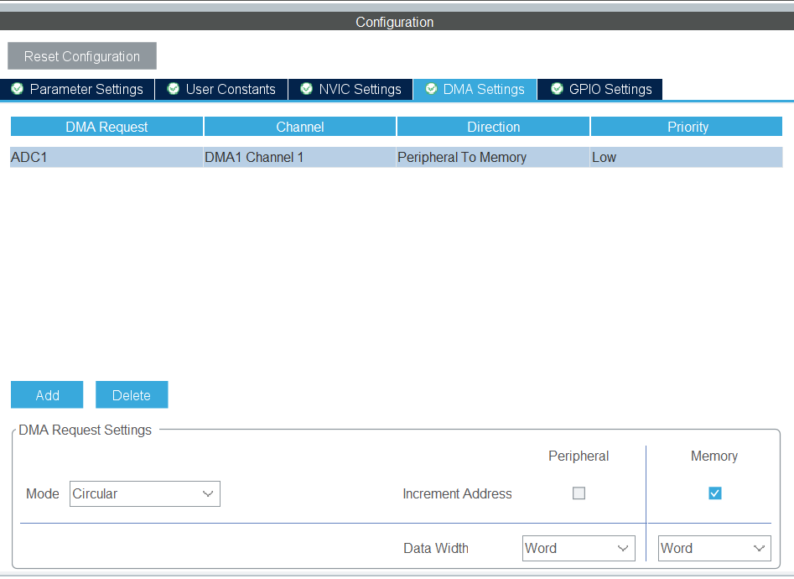
ADC Configuration

Slide 5
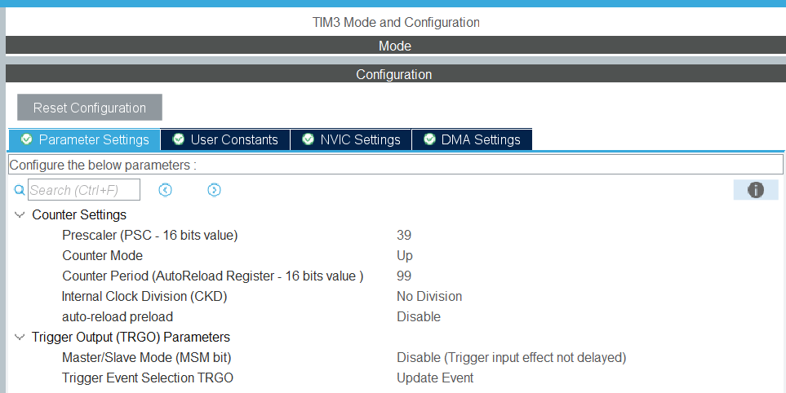
Timer Configuration
The timer was configured with PSC = 39 and ARR = 99 using a 4 MHz clock, resulting in an update frequency of 1000 Hz, which is the desired frequency for ADC sampling. The TRGO was enabled and set to the Update event, as shown in the image

Slide 6
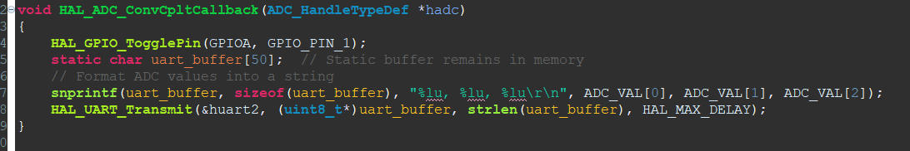
Timer Configuration
To verify that the timer triggers the ADC at a 1 kHz sampling rate, the code in the DMA callback was set to toggle a GPIO pin. Callback is trigger when DMA is finished transferring data. Using an oscilloscope, the toggle time was measured.

Slide 7
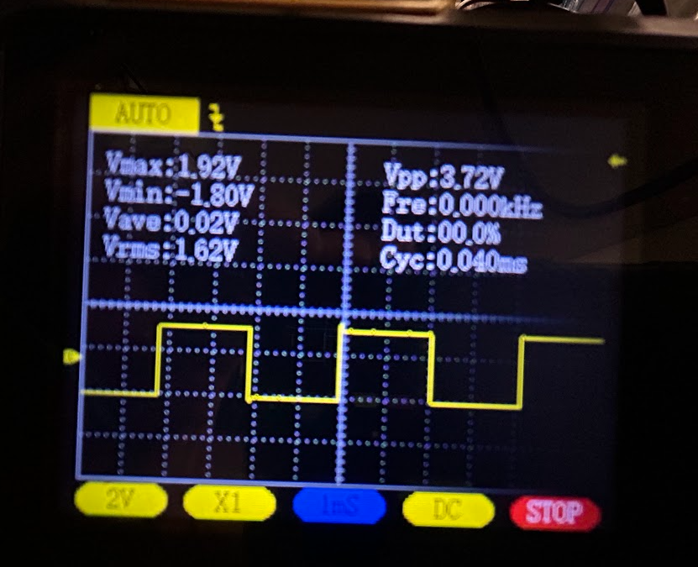
Timer Configuration
The DMA transfer is expected to complete and the callback invoked every 2 ms, resulting in a full cycle period of 4 ms. The oscilloscope image below shows a toggle time of approximately 2 ms from edge to edge and a complete period of 4 ms.

Slide 8
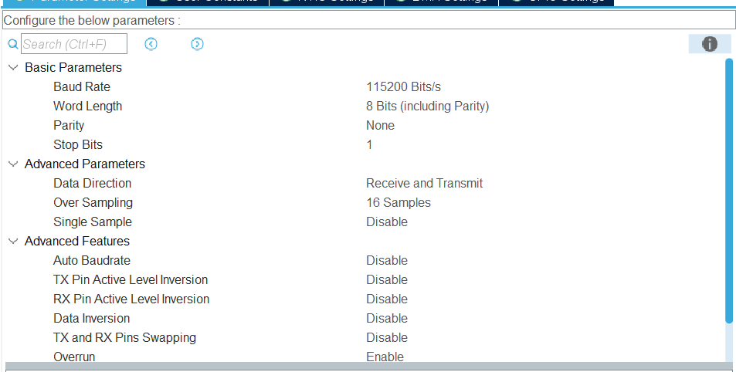
UART Configuration
The baud rate was set to 115,200 and UART2 was enabled

Slide 9
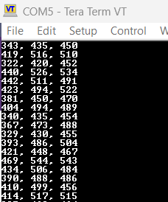
Verification values were transferred to the PC
To verify that the values are successfully transferred to the PC, the Tera Term program was used to monitor the UART output. As shown below, the values were successfully transmitted to the PC.

Slide 10
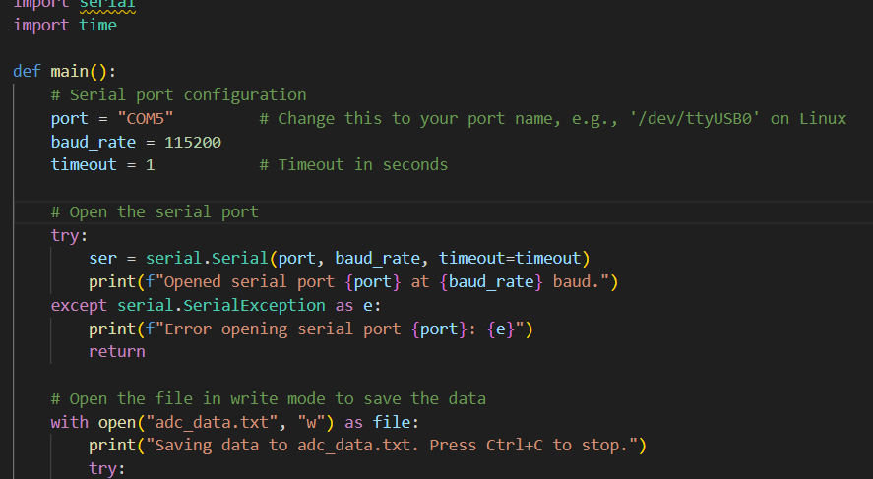
Python Script
The Python script collects the ADC values and saves them to a file. The ADC values were adjusted based on the sensor reference voltage and the STM32's reference voltage.

Slide 11
EMG classification
The EMG classification algorithm was verified to work on the Arduino for the Sony device and the PC.
The classification code is currently not working on the STM32.
Testing is needed to set up data transfer from the PC to the microcontroller and to evaluate the classification algorithm on the STM32.

Slide 12
Next steps
Next Week:
Debug the EMG classification algorithm on the STM32.
Verify that the system's classification functionality is working on stm32
Week After:
Integrate ADC data collection and EMG classification on the same system.
Develop a control system for the microcontroller to achieve full integration of the entire system.

